Slide 1
Tab Runs/Cost Audit Reports
Conduent
Government Healthcare Solutions

Slide 2
Purpose
The purpose of this PowerPoint is to provide an overview on the tab run process for Hospitals, Residential Treatment Centers, Federally Qualified Health Centers, Hospices, Rural Clinics, and Home Health providers.

Slide 3
Objectives
We will review the following areas as it pertains to Tab Runs and Cost Audit Reports:
Regular Tab Run Process
Reports Produced from a Request
Tab Run Request Process and Form
Retrieving Your Reports
Resources
Notes:
Modify the process, include one section for on-request tab runs.

Slide 4
Regular Tab Run Process
Conduent
Government Healthcare Solutions

Slide 5
Regular Tab Run Process
Paid Claims Reports also known as Tab Runs, are used to complete annual cost audits and are produced for all hospitals, residential treatment providers, FQHC’s, hospice providers, rural clinics, home health providers, and hospital-based rural clinics.
Regular Tab Runs are processed at the end of each month. Providers whose fiscal year end is either one month prior, or three months prior, to the run are included. The subsequent Tab Run reports are posted on the New Mexico Medicaid Web Portal in PDF files.

Slide 6
Reports Produced From A Request
Conduent
Government Healthcare Solutions

Slide 7
Reports Produced From A Request
A Summary selection will produce the following reports:
RC720: Medicaid Paid Claims Financial Summary
RC730: Medicaid Paid Claims Requested Period Summary
RC740: Medicaid Paid Claims Requested Period Services Rendered Summary
RC750: Medicaid Paid Claims Requested Period Grand Total
A Detail selection will produce all of the reports included above for Summary, PLUS the following reports:
RC760: Medicaid Paid Claims Requested Period Detail
RC770: Medicaid Paid Claims Requested Period Services Rendered Detail
Regardless of which selection is made, if there is TPL data, the request will also generate the following report:
RC765: Medicaid Paid Claims TPL Detail

Slide 8
Tab Run Request Process and Form
Conduent
Government Healthcare Solutions

Slide 9
Utilizing the On-Request Form
A new Tab Run/Cost Audit Request form is available for you to use.
Complete the Tab Run/ Cost Audit Request Form that is located on the NM Medicaid Web Portal (https://nmmedicaid.portal.conduent.com/static/Docs/MedicaidPubs/Tab%20Run-Cost%20Audit%20Request%20Form.docx) and submit to:
ABQOPS@Conduent.com.
The form is a Microsoft Word document. A copy of the form will appear on the next slide.
Notes:
Speaker Note: utilize the form to prevent missing information.

Slide 10
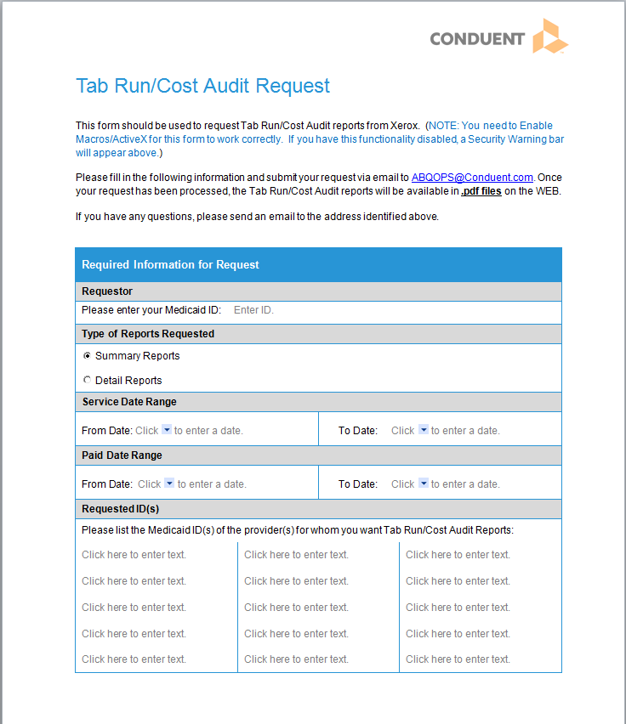
Tab Run/Cost Audit Request Form
Under the Forms section, click on the Tab Run / Cost Audit Request Form, to access the form:
https://nmmedicaid.portal.conduent.com/static/ProviderInformation.htm#FormsPubs

Slide 11
Tab Run Request Process
If you are unable to use the form, you may send all of the required information in an email. The required information includes:
Requestor ID – this is the Medicaid ID of the person making the request
Requested Provider ID – this is the Medicaid ID of the provider(s) that will appear on the reports
(In most cases, a & b will be the same provider ID)
Selection of Summary or Detail – identification of the type of reports being requested (see break out of reports below)
Service Period From & To Dates – these dates indicate which claims to include based on dates of service
Pay Period From & To Dates – these dates indicate which claims to include based on paid dates
Please note that providers who need Tab Runs/Cost Audit Reports outside the regular reporting schedule can make a request by sending the required information in an email to ABQOPS@Conduent.com.

Slide 12
Retrieving Your Reports
Conduent
Government Healthcare Solutions

Slide 13
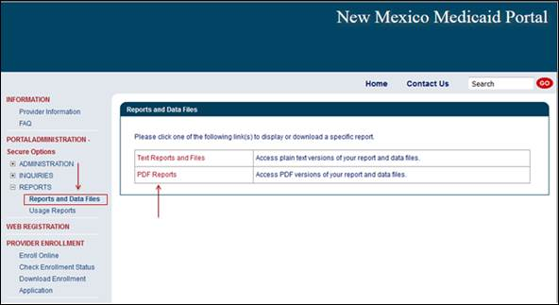
Retrieving Your Reports
Once your request has been submitted, the Tab Run/Cost Audit reports will be available in .pdf files on the NM Medicaid Web Portal within two (2) business days.
To retrieve your reports, log on to the web portal and select Reports on the left hand navigation bar. Then select Reports and Data Files. Then select PDF Reports.

Slide 14
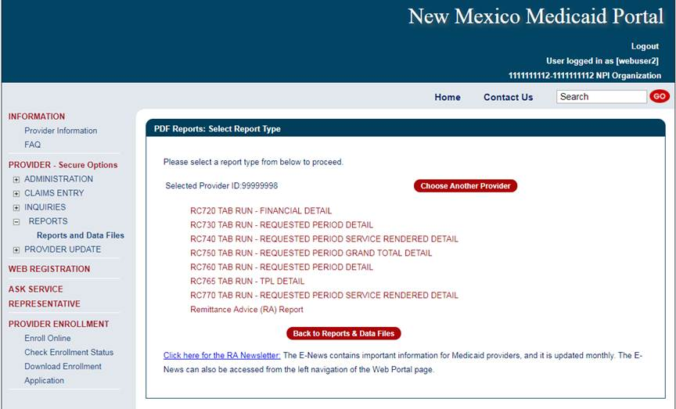
Your Tab Runs will be listed with your other reports.
The website will retain up to six (6) iterations of these reports.

Slide 15
New Mexico Medicaid Resources
New Mexico Medicaid Online
Provider Information
Provider Login Screen Notices
Provider E-News Newsletters
Medicaid Provider Relations Call Center
Provider Communication Updates
Provider Field Representative
Provider Webinars
Open Forums and Live Training Sessions
Continued on next page . . .

Slide 16
New Mexico Medicaid Resources Continued
New Mexico Medicaid Portal – https://nmmedicaid.portal.conduent.com/static/index.htm
Claim Inquiries, Eligibility Verification, Electronic Claim Submission, Provider Manuals, E-News
NM Health Care Authority – http://www.hca.nm.gov
Supplements, Memos, Provider Billing Packets and Policy
Medical Assistance Division – PE Program Staff – HSD.PEDeterminers@state.nm.us
Assistance with PE Applications, PE Determinations, MAD 070, PE Training, PE Certification
Consolidated Customer Service Call Center – (800) 299 - 7304
Claim Status, Eligibility, Prior Authorization, Medicaid Updates
Conduent Provider Relations Helpdesk – NMProviderSUPPORT@conduent.com
Claim research assistance and general Medicaid inquiries
Conduent HIPAA Helpdesk – HIPAA.DeskNM@hsd.nm.gov Assistance on NM Web Portal, EDI inquiries, and Online Claim Submission with DDE (Direct Data Entry)
Conduent Provider Enrollment Helpdesk - NMProviderSUPPORT@conduent.com
Provider Enrollment Applications, Forms & Instructions
Medical Assistance Division, Program Rules – http://www.hca.nm.gov/providers/rules-nm-administrative-code/
NMAC for Programs administered by the Medical Assistance Division Yes New Mexico - https://www.yes.state.nm.us/yesnm/home/index Apply, check, update, or renew Medical Assistance (Medicaid) benefits

